Slide 1
Microprocessor Architecture ECE4375 / ECE5375
Dr. Argenis Bilbao
Spring 2026

Slide 2
Presentation Outline
Introduction to Caches and memory

Slide 3
Hierarchical Memory Model
CPU is much, much faster than the bulk of memory
Ideally memory is unlimited and extremely fast
  Fast memory is very expensive
  Large amounts of memory can be slow due to propagation delay accumulation and other factors
Tradeoffs
  Cost-speed and Size-speed
Solution:
  Smaller, faster expensive memory close to CPU or “cache”
    Most caches are made with SRAM
  Larger, slower, cheaper memory farther away
    Most cheap memory is made with DRAM

Slide 4
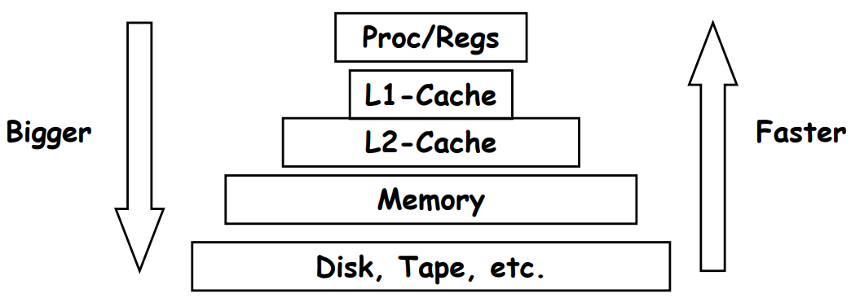
What is Cache Memory?
Small, fast storage used to improve average access time to slow memory
Holds a subset of the instructions and data used by programs
Exploits spatial and temporal locality
  Temporal locality refers to the reuse of specific data and/or resources within a relatively small-time duration
  Spatial locality (also termed data locality) refers to the use of data elements within relatively close storage locations

Slide 5
Caches are Everywhere!
In computer architecture, almost everything is a cache of some sort
  CPU registers are often used as cache on variables
  First-level cache is a cache for second-level cache
  Second-level cache is a cache for third-level cache
  Third-level cache is a cache for main memory
  Main memory is a cache to the disk storage sub-system

Slide 6
Program Locality is Why Caches Work
Memory hierarchy exploit program locality:
  Programs tend to reference parts of their address space that are local in time and space
  Temporal locality: recently referenced addresses are likely to be referenced again
  Spatial locality: If an address is referenced, nearby addresses are likely to be referenced soon
Programs that don’t exploit locality wont benefit from caches!

Slide 7
Terminology
Higher Levels in the hierarchy are physically closer to the CPU
At each level a block is the minimum amount of data whose presence is checked at each level
  Blocks are also often called lines
  Block size is always a power of 2
  Block sizes of the lower levels are usually fixed multiples of block sizes of the higher levels
A reference is said to hit a particular level if the block is found at that level
  Hit Rate (HR) = hits/references
  Miss Rate (MR) = misses/references
Access time of a hit is the hit time
The additional time to fetch a block on a miss is called the miss penalty

Slide 8
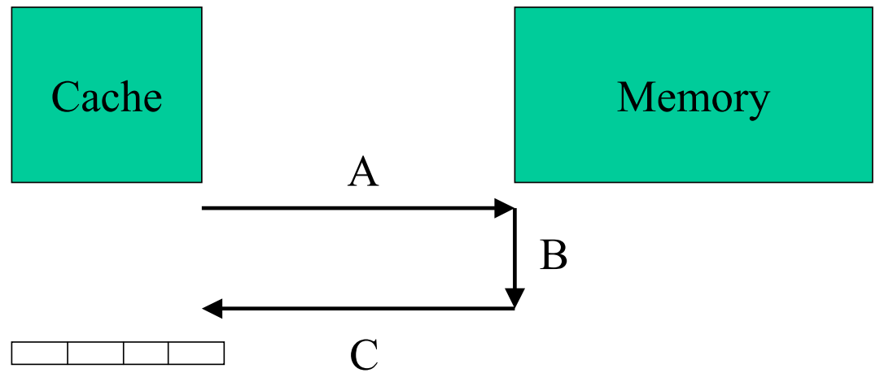
Terminology
Miss Penalty = Access Time + Transfer Time
Access time is a function of latency
  Time for memory to get request and process it
Transfer time is a function of bandwidth
  Time for all of block to get back
Miss penalty = A + B + C
Access time = A + B
Transfer time = C

Slide 9
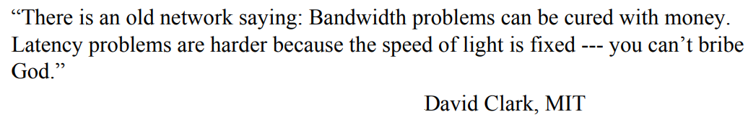
Latency vs. Bandwidth
Recall pipelining: We improved instruction bandwidth/throughput, but made latency worse
With memory, to improve bandwidth we can:
  Use/make/design wider buses, larger block sizes, new DRAM organizations and technologies
Latency is much harder:
  Must get request from cache to memory (off-chip)
  Must do memory lookup (internal to memory module)
  Must have information travel back on wire onto the on-chip cache

Slide 10
SRAM vs. DRAM Bandwidth
  DDR5 Module Bandwidth (32 GB):
  Specification Says bandwidth is 4.8 Gb per second for base models
  Can scale up to 8.4 Gbps
  One transistor and one capacitor
  $
  SRAM Bandwidth (18 Mb):
  36 bits every 450ps or 36 bits 2.23 giga times per second
  Chip bandwidth = 80 Gb per second
  If we use 2 chips for a 64-bit bus, we get a module bandwidth of 160 Gb per second
  6-7 transistors per bit (flip-flop)
  $$$$$$$$$$$$$$$$$$$$$$$$$$$$

Slide 11
SRAM vs. DRAM Latency
  DDR5 Module Latency:
  SRAM Latency (18 Mb):
  450 ps
Technology | Module Speed (MT/s) | Clock Cycle Time(ns) | CAS Latency | Latency (ns)
SDR | 100 | 8.00 | 3 | 24.00
SDR | 133 | 7.50 | 3 | 22.50
DDR | 333 | 6.00 | 2.5 | 15.00
DDR | 400 | 5.00 | 3 | 15.00
DDR2 | 667 | 3.00 | 5 | 15.00
DDR2 | 800 | 2.50 | 6 | 15.00
DDR3 | 1333 | 1.50 | 9 | 13.50
DDR3 | 1600 | 1.25 | 11 | 13.75
DDR4 | 1866 | 1.07 | 13 | 13.93
DDR4 | 2133 | 0.94 | 15 | 14.06
DDR4 | 2400 | 0.83 | 17 | 14.17
DDR4 | 2666 | 0.75 | 19 | 14.25
DDR4 | 2933 | 0.68 | 21 | 14.32
DDR4 | 3200 | 0.62 | 22 | 13.75
DDR5 | 4800 | 0.42 | 40 | 16.67

Slide 12
SRAM vs. DRAM Latency
  DDR5 Module Latency:
  Without cache CPU running at 5.8 GHz would have to sit and wait for memory for ~96 cycles per transfer
  Equivalent to cutting down the CPU frequency to 60 MHz if one transfer is performed per instruction fetched!!!

Slide 13
Caching Basics
  Most basic caching questions:
    How do we know if data item is in the cache?
    If it is, how do we find it?
    If it isn’t, how to we get it?

Slide 14
More Detailed Questions
  Block placement policy?
    Where does a block go when it is fetched?
  Block identification policy?
    How do we find a block in the cache?
  Block replacement policy?
    When fetching new information and the cache is full, under what conditions do we get another block kicked out?
  Write strategy?
    Does any of the above change for reads vs. writes?

Slide 15
Simple Cache Example
  Direct-mapped cache: Each block has a specific spot in the cache. If it is in the cache, only one place for it
  Makes block placement, ID, and replacement policies easy
    Block Placement: Where does a block go when fetched?
  It goes to its one assigned spot
    Block ID: How do we find a block in the cache?
  We look at the tags for that one assigned spot
    Block replacement: What gets kicked out?
  Whatever is in its assigned spot
  8 locations in our cache
  Block Size = 1 byte

Slide 16
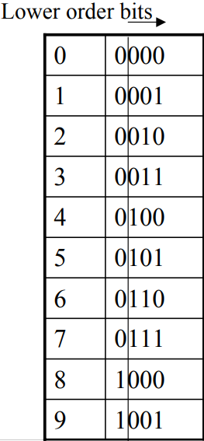
Simple Cache Example
  Data reference stream:
  References to memory locations:
    0,1,2,3,4,5,6,7,8,9,0,0,0,2,2,2,4,9,1,9,1
  Entry = address%cacheSize

Slide 17
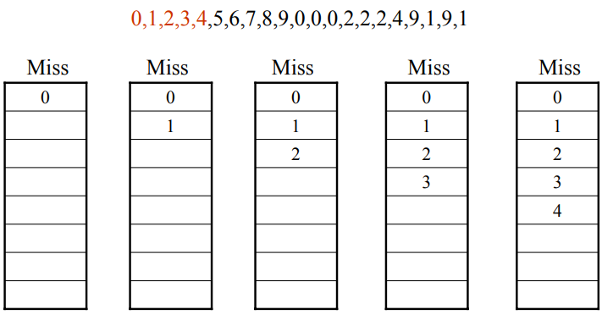
Simple Cache Example: Cycles 1 - 5

Slide 18
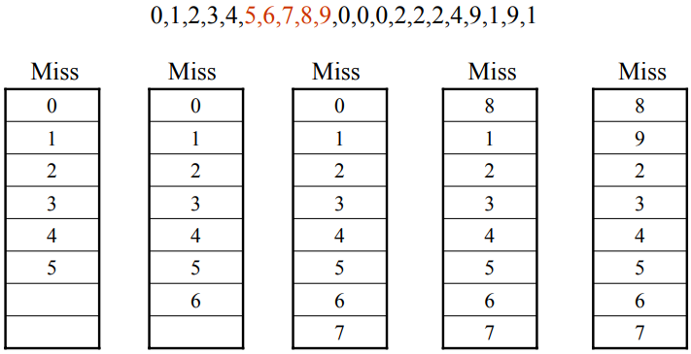
Simple Cache Example: Cycles 6 - 10

Slide 19
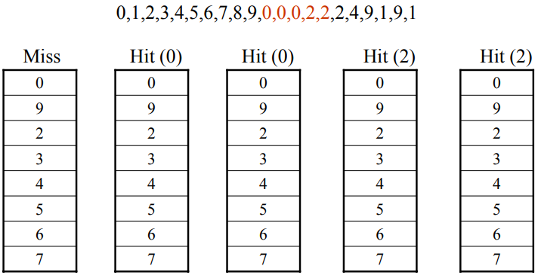
Simple Cache Example: Cycles 11 - 15

Slide 20
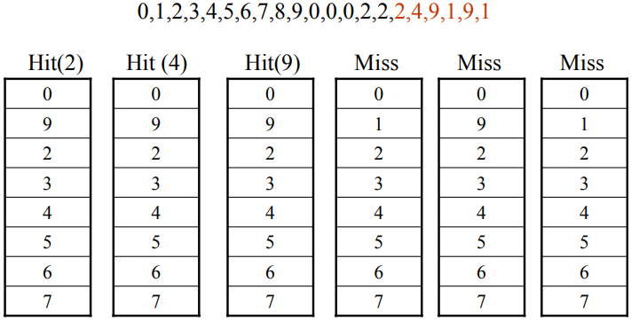
Simple Cache Example: Cycles 16 - 21

Slide 21
Sources
http://www.eecs.harvard.edu/cs146-246/
Assigned Textbook
https://en.wikipedia.org/wiki/Locality_of_reference#:~:text=There%20are%20two%20basic%20types,within%20relatively%20close%20storage%20locations.
https://en.wikipedia.org/wiki/DDR5_SDRAM

